Slide 1
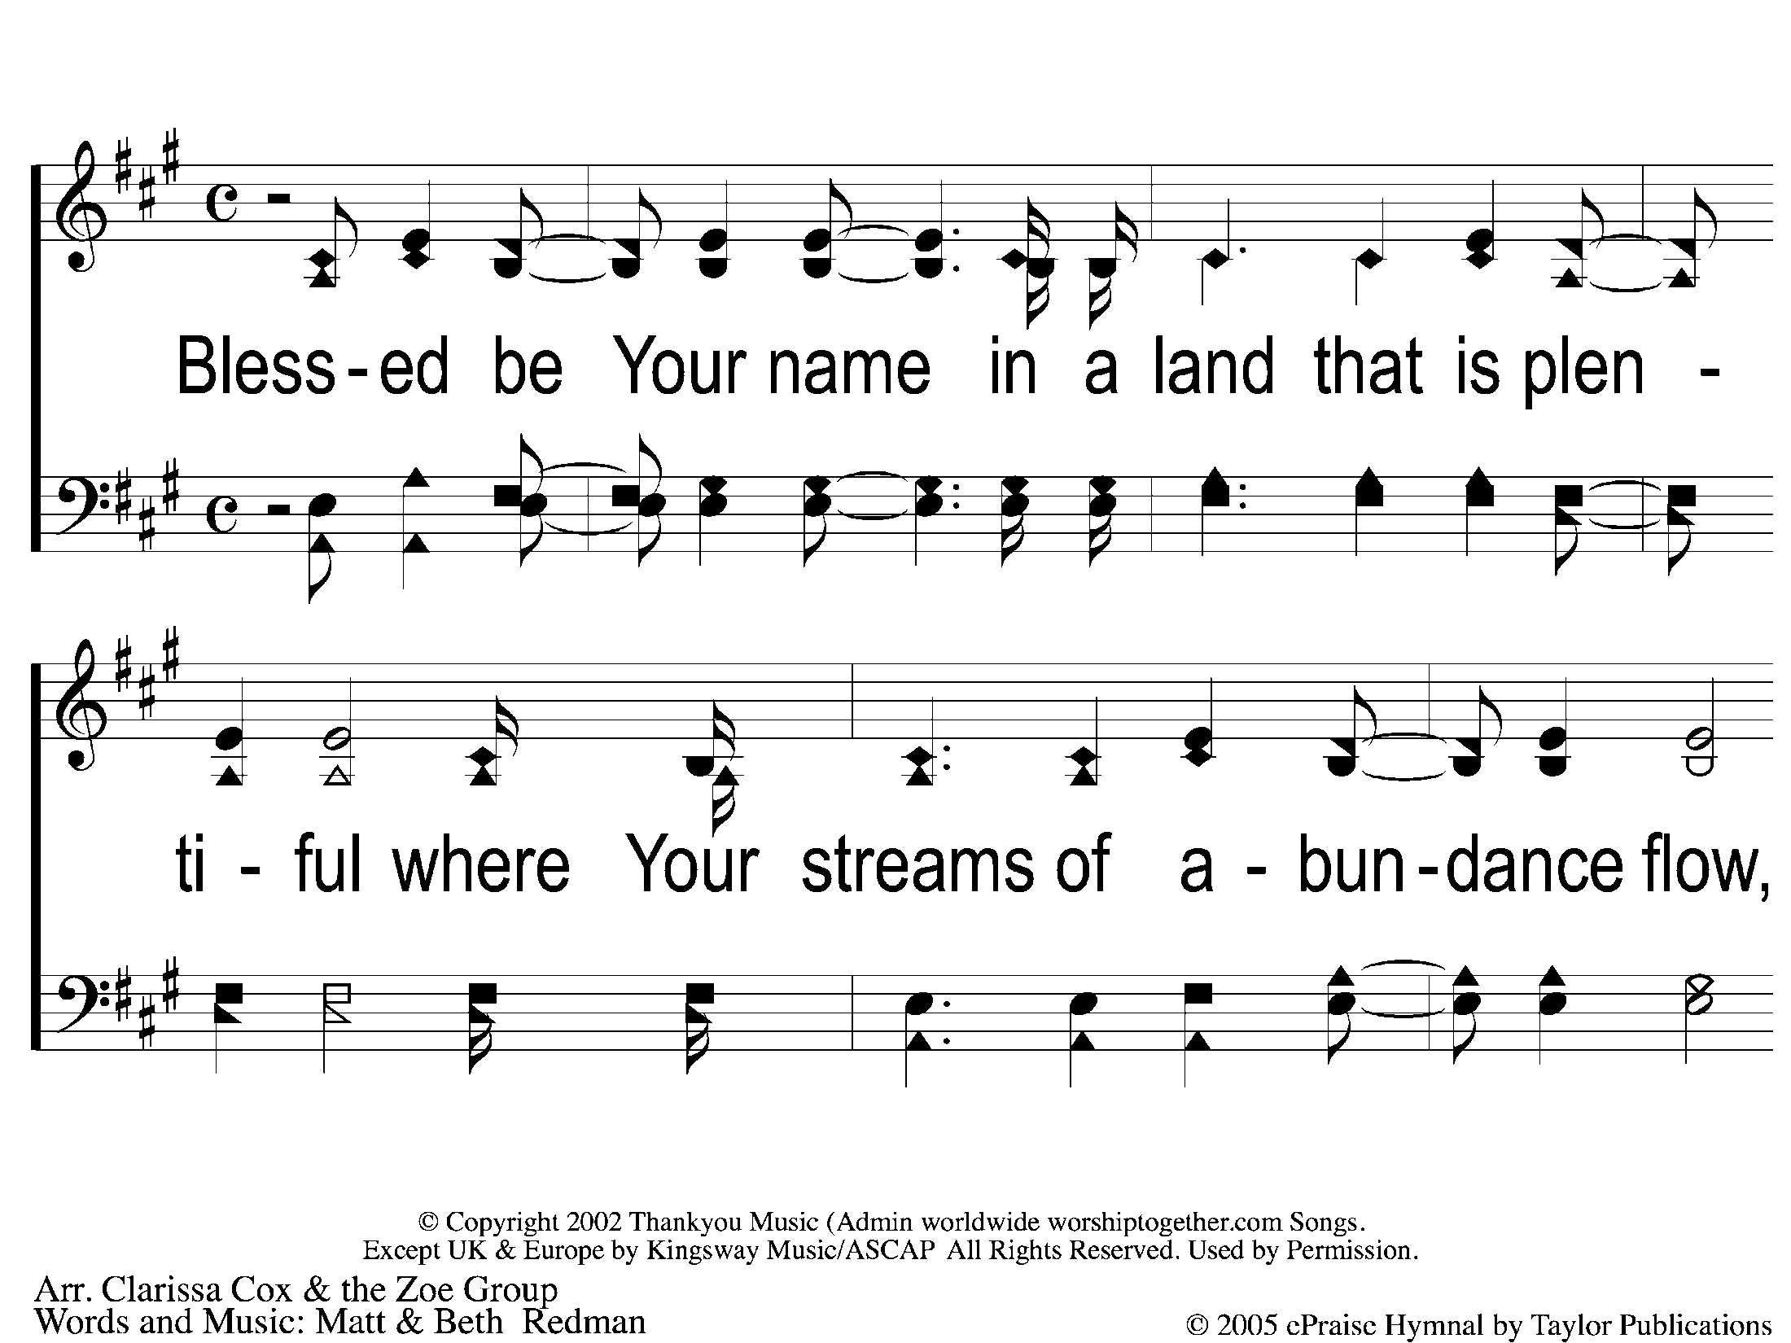
1-1 Blessed Be Your Name
Blessed be Your Name

Slide 2
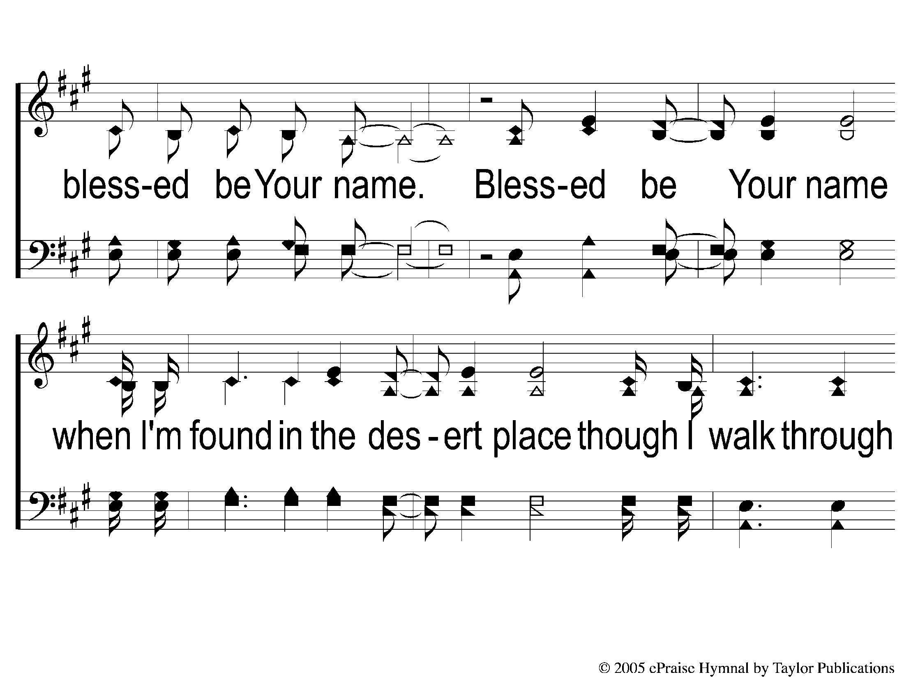
1-2 Blessed Be Your Name
Blessed be Your Name

Slide 3
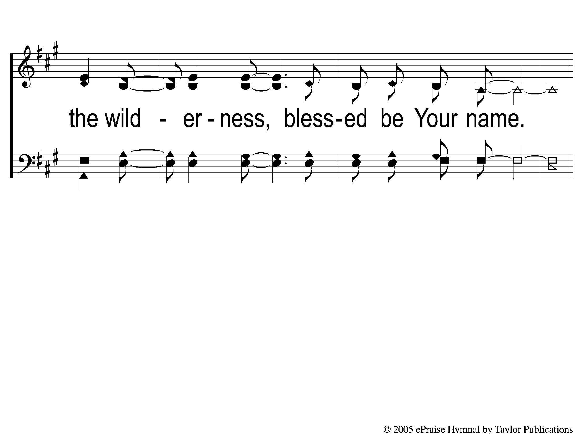
1-3 Blessed Be Your Name
Blessed be Your Name

Slide 4
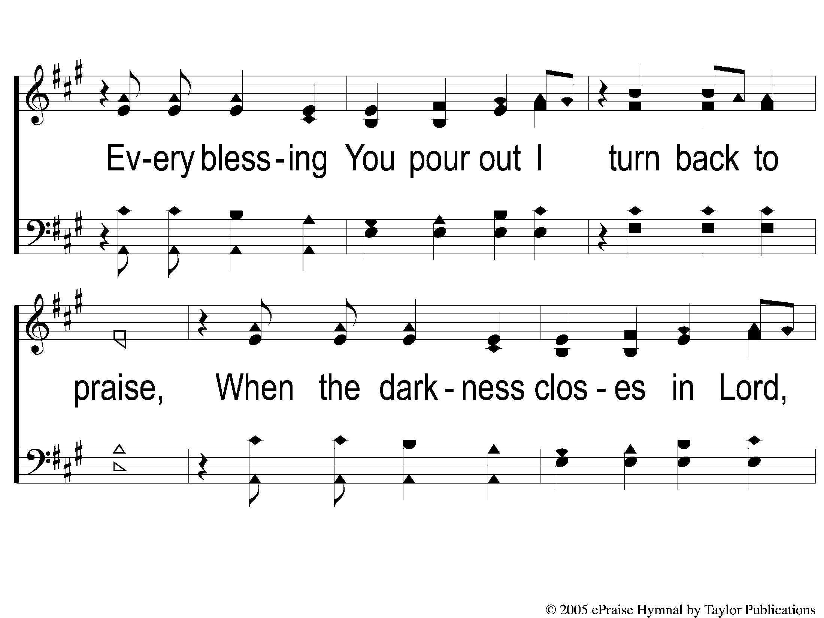
C-1 Blessed Be Your Name
Blessed be Your Name

Slide 5
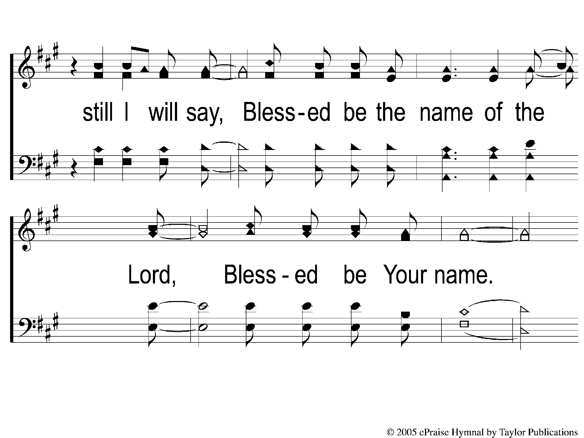
C-2 Blessed Be Your Name
Blessed be Your Name

Slide 6
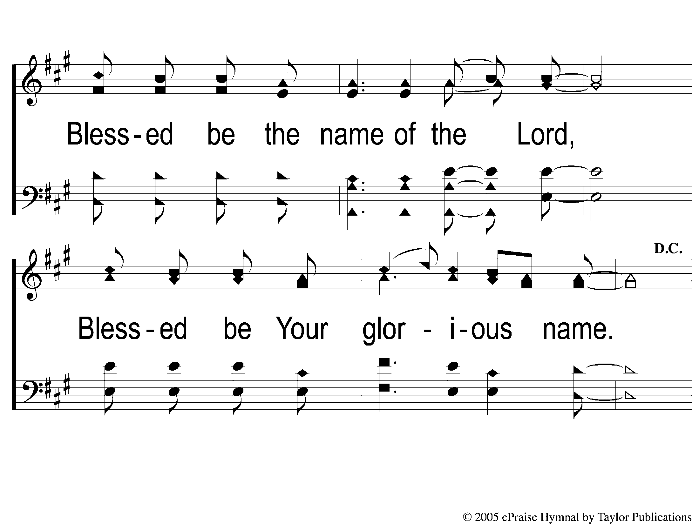
C-3 Blessed Be Your Name
Blessed be Your Name

